Slide 1
CIML Agenda Item 21.1
Report of the RLMO Round Table
Chairperson
Dr. Charles Ehrlich, CIML 1st VP

Slide 2
Since the 2021 RLMO RT Annual Meeting
The RLMO RT held two (virtual) Interim Meetings in 2022:
20 January 2022
27 May 2022
Short update presentations from the RLMOs on matters of interest/urgency, including training, were permitted, but they were not required;
Two presentations were provided on specialty topic (smart meters);
Plans were made for the 2022 Annual RLMO RT Meeting (27 September).

Slide 3
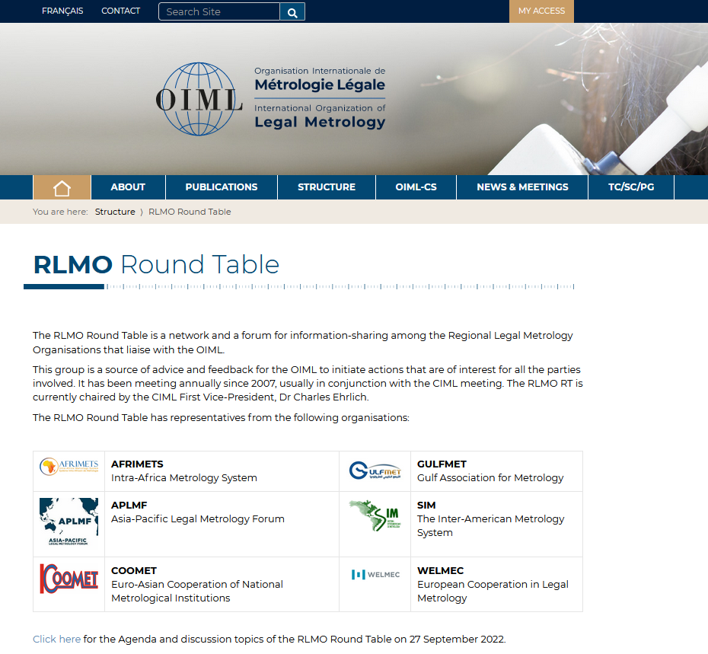

Slide 4

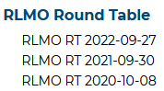

Slide 5
RLMO Round Table Annual Meeting
Tuesday, 27 September 2022
10:00–14:00 UTC
Agenda
(v.3, 2022-09-22)
Welcome by the RLMO RT Chairperson (Dr. Charles Ehrlich)
Roll call
Update from the Round Table Chairperson
Updates from the RLMOs
  SIM (Ms Sandra Rodríguez)
  GULFMET (Eng. Amina Al Bastaki)
  COOMET (Dr. Valery Hurevich)
  APLMF (Dr. Osman Zakaria)
  AFRIMETS (Mr. Jaco Marneweck)
  WELMEC (Dr. Pavel Klenovský)
Open Forum on the 2022 RLMO discussion topics (‘Digitalization’ and ‘Smart Meters’)
Coordination/Planning of OIML Bulletin Issue for April 2023 on RLMOs and Prepackaged Products
continued

Slide 6
RLMO Round Table Annual Meeting
Tuesday, 27 September 2022
10:00–14:00 UTC
Agenda (continued)
(v.3, 2022-09-22)
7. Update on the CEEMS AG (Mr. Peter Mason)
8. Update on the OIML-CS (Mr. Mannie Panesar/Mr. Paul Dixon)
9. Business meeting to address other ongoing RLMO and relevant OIML matters
  Decision to hold either one or two Interim RT Meetings per year?;
  Have talks on specialty topics at 2023 Interim RT Meeting(s)?;
  Open Forum Discussion Topic(s) for 2023?;
  Key 2022 CIML Meeting Topics (e.g., OIML B 12 revision);
  Any change in view about making relationship between RLMOs and OIML more formal?;
  Updates on PG Workspace(s) and OIML Web Site for RLMO RT;
  Follow-up interactions with EURAMET?;
  E-learning progress/initiatives?;
  How to better engage CEEMS countries/economies in the RT?;
  Other?
10. Future collaborations
11. Conclusions
12. Any other business

Slide 7
  9. Business meeting to address other ongoing RLMO and relevant OIML matters
  Decision to hold either one or two Interim RT Meetings per year?
    Two Interim Meetings, one in January and one in May, 2023.
  b. Have talks on specialty topics at 2023 Interim RT Meeting(s)?
  - Electric Vehicle Supply Equipment (EVSE)
  - Measurements in Law Enforcement
  c. Open Forum Discussion Topic(s) for 2023?;
      - Digitalization
    - Smart Meters
    - Electric Vehicle Supply Equipment (EVSE)
    - Measurements in Law Enforcement

Slide 8
  9. Business meeting to address other ongoing RLMO and relevant OIML matters
  d. Key 2022 CIML Meeting Topics (e.g., OIML B 12 revision);
    OIML B 12 (Policy paper on liaisons between the OIML and other bodies)
    “OIML Policy concerning coordination with RLMOs will be routinely considered annually at RLMO Round Table Meetings.”
  e. Has there been any change in the view about making relationship between RLMOs and OIML more formal?;
  No. The RLMOs prefer to keep the current arrangement, where the RLMOs are entirely independent of OIML on a formal basis but continue to interact with OIML through the Round Table. Also, the RLMOs benefit from participation of OIML-CS representatives in some RLMO meetings. Some of the RLMOs have established bilateral arrangements.

Slide 9
  9. Business meeting to address other ongoing RLMO and relevant OIML matters
  f. Updates on PG Workspace(s) and OIML Web Site for RLMO RT;
  The OIML Website and PG Workspaces for the RT have been significantly upgraded this year by the BIML Staff!
  Follow-up interactions with EURAMET?;
  At the May 2022 Interim RT Meeting Dr. Jörn Stenger, Chairman of EURAMET, made a presentation welcoming collaboration with the RLMOs, singularly or as a group. At the annual RT meeting it was reported that GULFMET has explored this, and WELMEC has ongoing relations with EURAMET.

Slide 10
  9. Business meeting to address other ongoing RLMO and relevant OIML matters
  f. E-learning progress/initiatives?;
    Report provided by Mr. Dunmill. Computer hardware at BIML is now available, software is still being pursued. Possible incorporation of e-learning materials from APLMF is also being explored.
  How to better engage CEEMS countries/economies in the RT?;
    This will continue to be pursued, although the CEEMS countries/economies are typically more engaged in the individual RLMO meetings. The particular matter of better addressing CEEMS needs for R 76 initial and subsequent verification was briefly discussed.

Slide 11
Brief Highlights from the 2022 RLMO RT Presentations
AFRIMETS: 15th AFRIMETS General Assembly took place virtually from 18 to 21 July 2022 the main focus being the self-sustainability of AFRIMETS
- Meeting of AFRIMETS Technical Committee Legal and a Workshop took place virtually before the AFRIMETS GA from 12 to 13 July 2022
- AFRIMETS TC Legal Workshop that was held on 13 July 2022 focused on the regulation of smart electricity meters and was led by 3 distinguished international guests :
Dr. Pavel Klenovský -Czech Metrology Institute Brno
Dr Juan Carlos Mateus Sánchez -INMETRO
Ms Sowmya Ramakrishnan -National Measurement Australia (NMIA) co-convener for the OIML TC 12/p 1.
AFRIMETS TC LEGAL decided that this workshop will be followed–up by similar such workshops.

Slide 12
Brief Highlights from the 2022 RLMO RT Presentations
APLMF: Malaysia is the Secretariat; 27 APLMF member economies.
Besides e-learning modules and training courses on NAWIs and Fuel Dispensers, new workshops and training are envisioned on software, belt weighers and weighing-in-motion technology. Focus on e-learning will be maintained.
APLMF is adding two new Working Groups, on ‘Measurement of fuel’ and ‘Medical measurement’, bringing the total to eight Working Groups.

Slide 13
Brief Highlights from the 2022 RLMO RT Presentations
COOMET: Currently 14 Full Members and 5 Associate Members
In 2022 work of COOMET TC 2 "Legal Metrology" continued on the translation of a number of OIML publications (D1:2020, D10, D30, D32, R75, G14) and the Brochure UNIDO-OIML "Certification of measuring instruments".
Tasks of COOMET TC 2 for 2022-2023:
translation of D11, D31, D 33, R125;
update of COOMET Recommendations;
implementation of the COOMET project (716/BY-а/17 "Development of rules for setting up reverification and recalibration intervals for measuring instruments used in the field of LM" and 797/BY/19 "Review of approaches to the metrological support of medical measuring instruments").

Slide 14
Brief Highlights from the 2022 RLMO RT Presentations
COOMET: continued
In August - September 2022 a survey was conducted among members of COOMET TC 2 on the issue "Regulation of smart meters". It is appropriate to continue discussion of the problem of using smart meters in COOMET countries within TC 2.
In 2022 a COOMET Task Group on the Issues of Digital Transformation in Metrology was established. A draft COOMET Concept for the issues of digital transformation in metrology and Roadmap for the implementation of the Concept are under discussion.
The 23rd COOMET TC 2 online meeting will be held in December 2022.
The 33rd COOMET Committee online meeting will be held on 25 to 27 October 2022.

Slide 15
Brief Highlights from the 2022 RLMO RT Presentations
GULFMET: A GCC Certification Scheme is being developed based on the OIML-CS.
Also, the GCC Common Metrology Law has been updated and put forward to the Ministerial Committee.
GULFMET attended the CEEMS AG meeting in July 2022.
GULFMET participated in-person at the IMEKO Conference on ‘Metrology and Digital Transformation’ held in Berlin in September 2022.

Slide 16
Brief Highlights from the 2022 RLMO RT Presentations
SIM: A Repository of metrological verification of prepackaged products in the SIM countries is progressing using a template.
The SIM Web Page on Legal Metrology has been updated, and meetings of the SIM LMWG are being held every three months.
Training courses in the areas of Energy Meters, Non-Automatic Weighing Instruments, Fuel Dispensers and Software were identified as key needs in the SIM countries.
SIMEL (Colombia), RBMLQ-I (Brazil), SICOMET (Argentina) and, recently, INACAL (Peru) continue to work on Digitalization systems in their countries.
Regulation of Smart Electricity Meters is also becoming a priority in some of the SIM countries.

Slide 17
Brief Highlights from the 2022 RLMO RT Presentations
WELMEC: Short (10-minute) talks on hot issues in legal metrology through a “technical exchange” will be given at future WELMEC Committee Meetings.
WELMEC is launching regular annual or biannual webinars to inform stakeholders about new developments in WELMEC activities. The first will be on November 23, 2022, on fitness-for-purpose of the European Directives in metrology.
WELMEC has approved 9 revised Guides, 2 new Guides and 1 ‘corresponding table’ at the last Committee Meetings. The next Committee Meeting will be 3-5 May, 2023, in Braunschweig.

Slide 18
Brief Highlights from the 2022 RLMO RT Presentations
WELMEC: continued
WELMEC remains active in providing guidance to the European Commission on Active Electric Energy Meters.
A new WELMEC Working Group has been established on Digital Transformation. Draft Terms of Reference have been established by the WELMEX Executive Board.
An article on legal metrology for the magazine Nature Physics, titled “The Metrology behind Trade”, prepared by the WELMEC Chair and Executive Board members, has now been published (see link in posted WELMEC power point presentation).

Slide 20
CIML Agenda Item 21.1
Report of the RLMO Round Table
Chairperson
Thank you for your attention!

